Slide 1
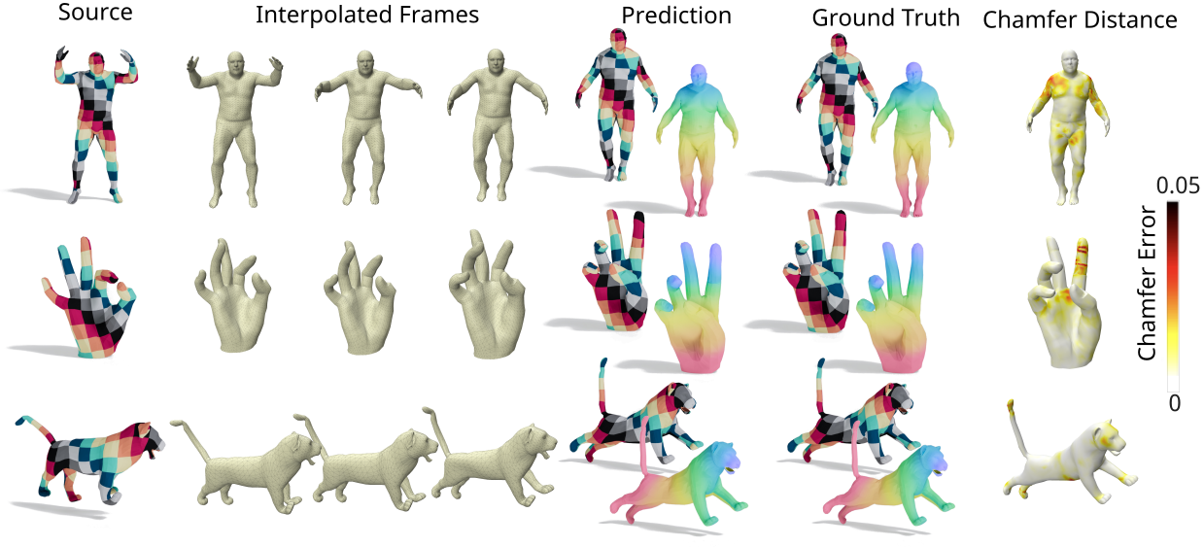
=-----
Curvature Enthusiasm
Correspondence-Free Interpolation & Matching of Articulated 3D Shapes using Compressed Normal Cycles
Adam Hartshorne , Allen Paul , Tony Shardlow & Neill D. F. Campbell
Notes:
Good afternoon. I’m Adam Hartshorne from the University of Bath.
Today I’ll present Curvature Enthusiasm, an unsupervised method for learning physically plausible interpolations and dense correspondence across poses of articulated 3D shapes.
This is joint work with Allen Paul, Tony Shardlow, and Neill Campbell.

Slide 2
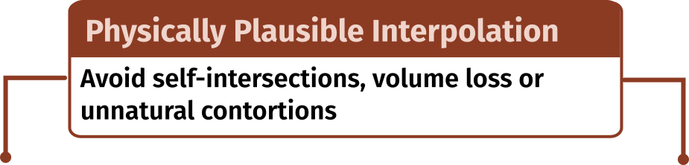
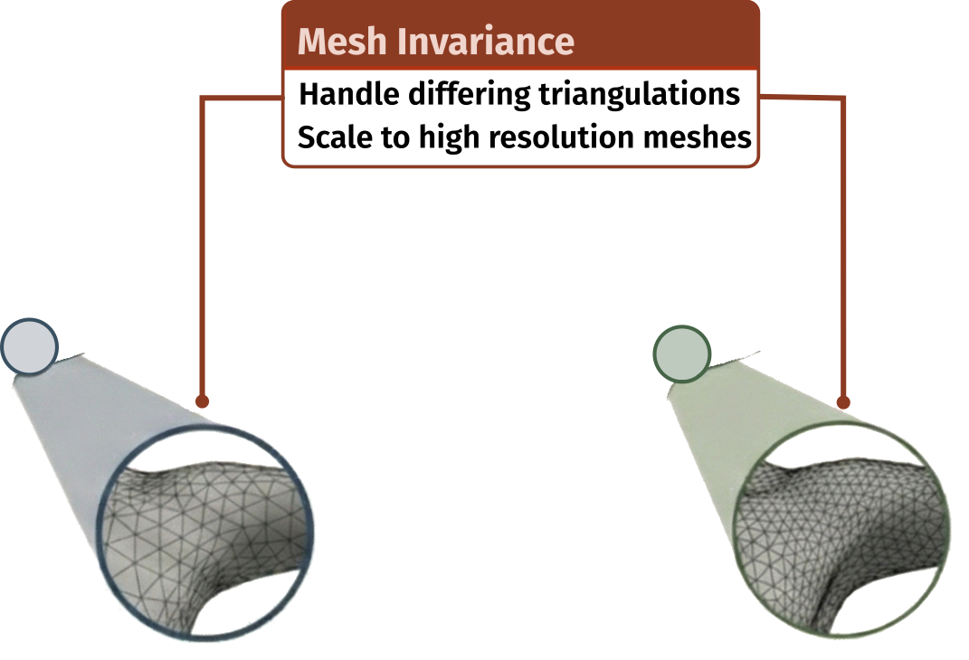
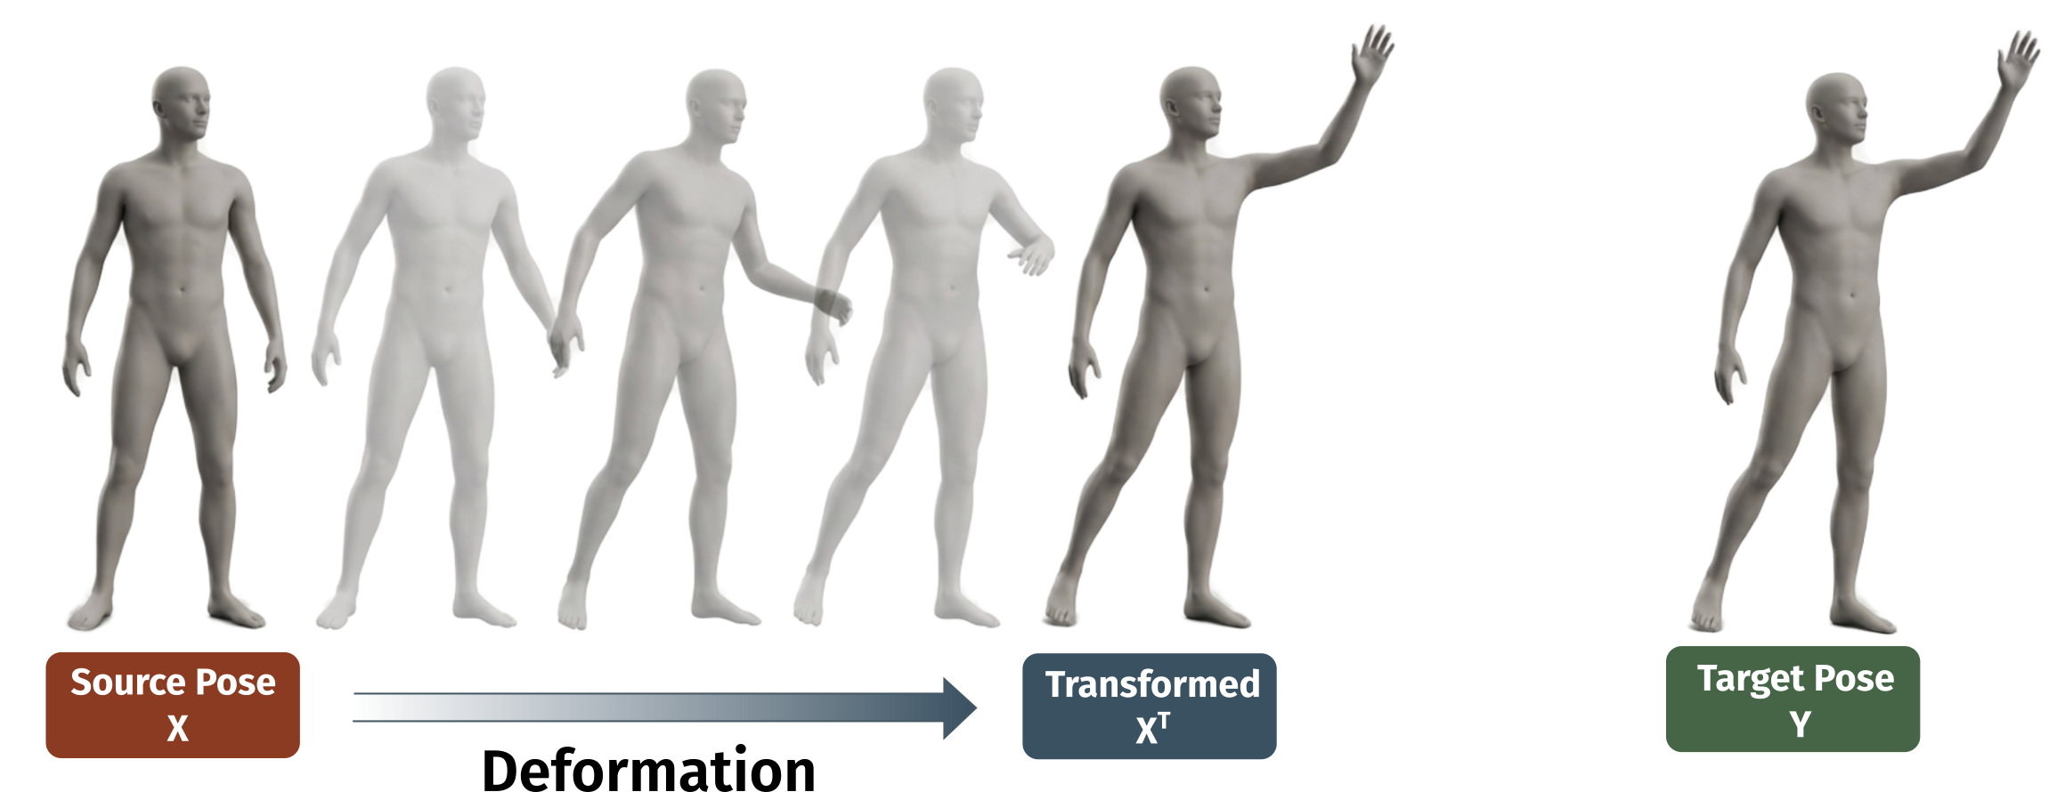
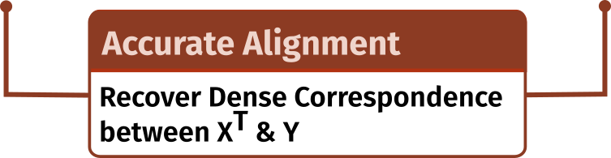
Motivation
Notes:
Recovering maps between 3D shapes without known correspondence is a fundamental problem in graphics, crucial for tasks such as fitting templates to raw data scans, texture transfer, and key-frame interpolation.
This is particularly challenging for real-world articulated shape capture, where noise and non-isometric motion are compounded by inconsistent mesh paramaterisation.
Deformation and correspondence are deeply coupled, yet often solved separately—ignoring the proven accuracy gains of a joint formulation
Therefore our goal is threefold:
CLICK to produce physically plausible interpolations
CLICK to recover accurate dense correspondences
CLICK and to achieve both in a mesh-invariant manner that scales to high-resolution surfaces.

Slide 3
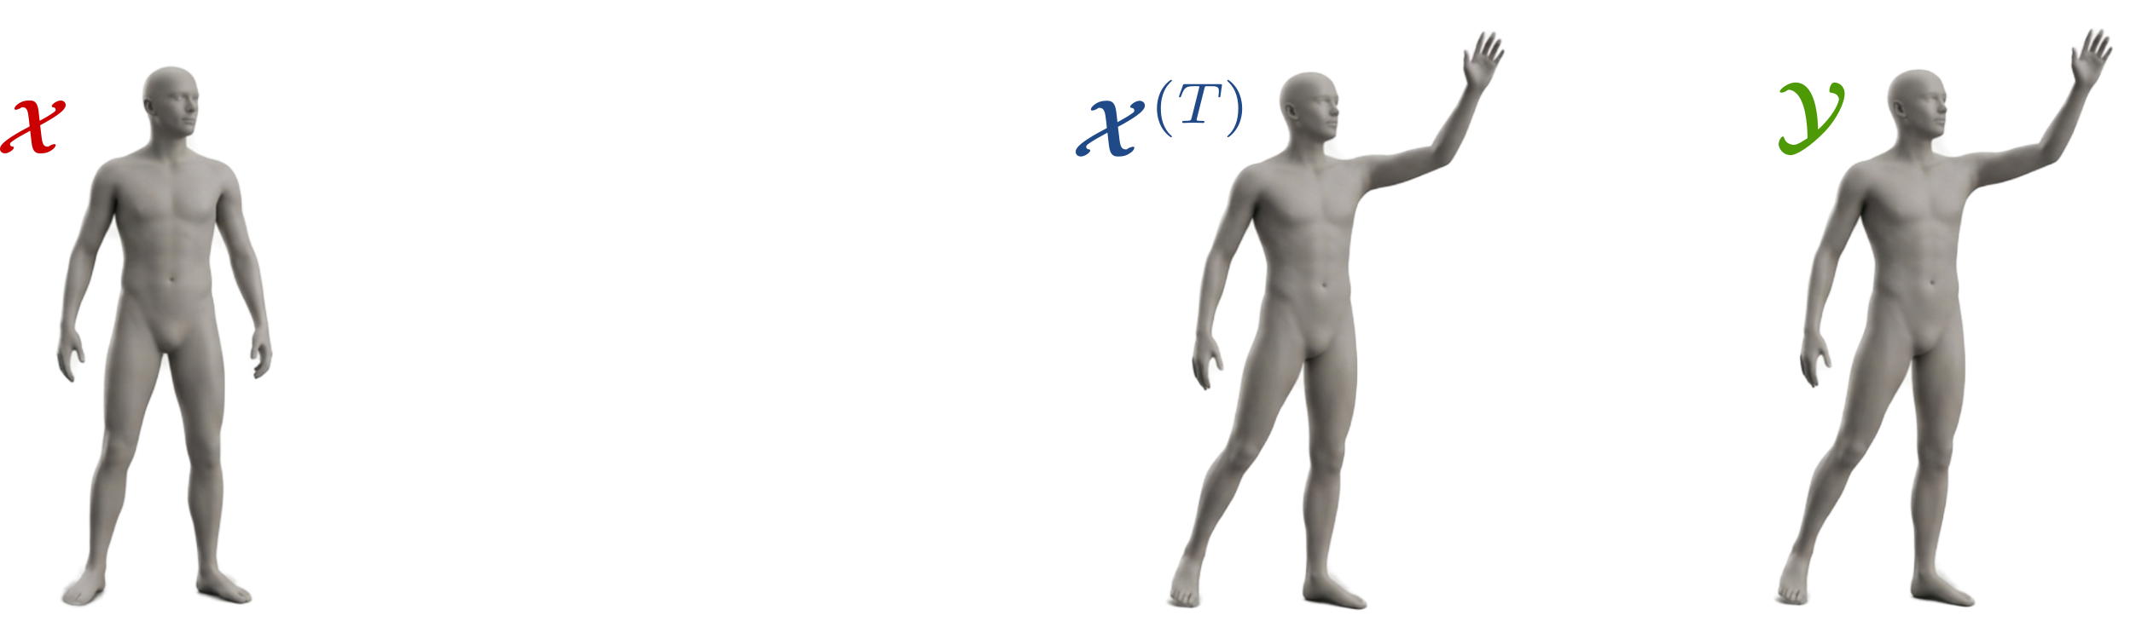
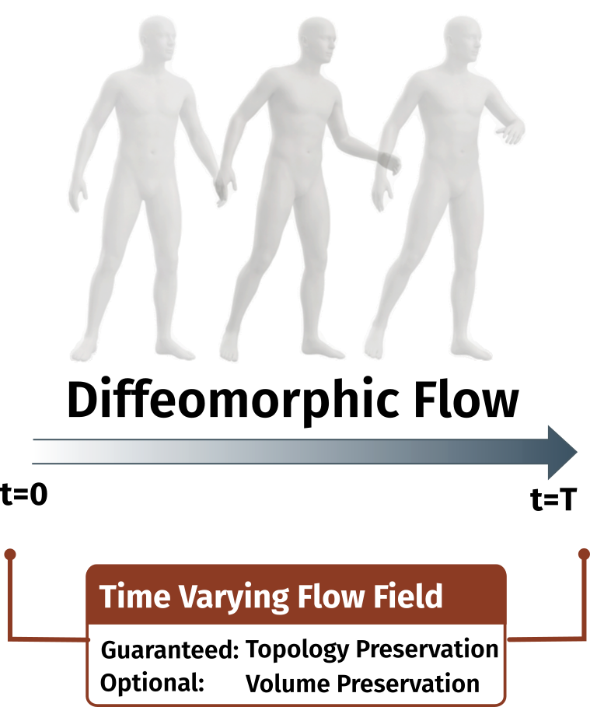
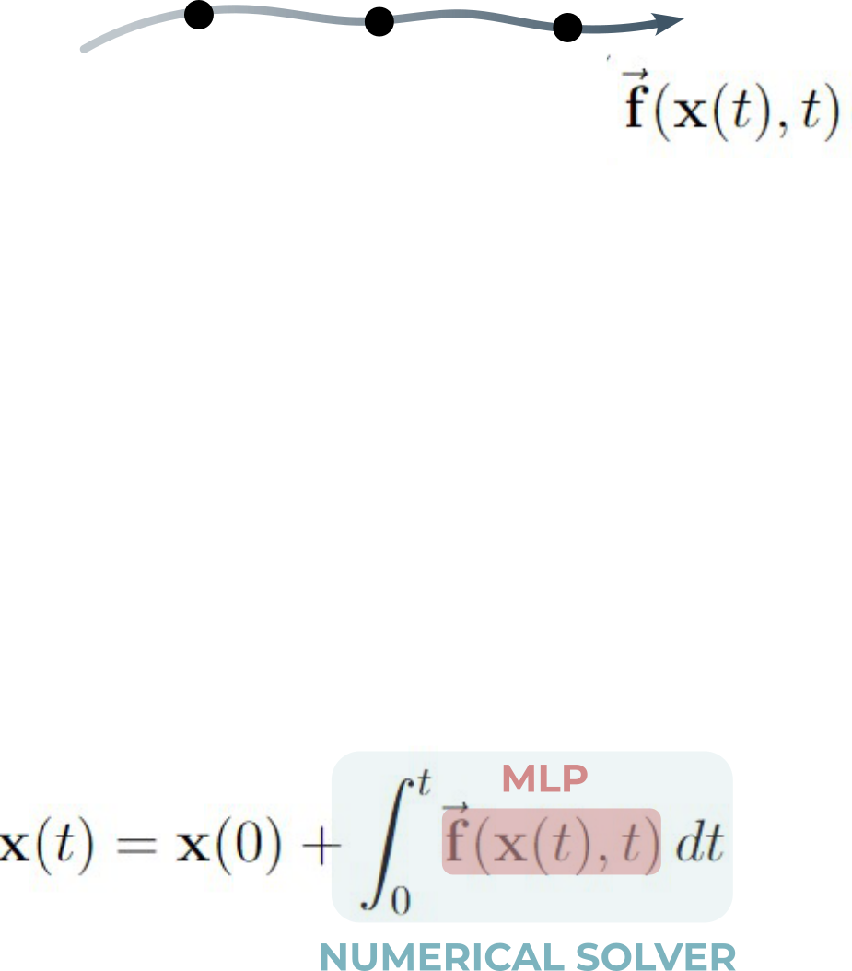
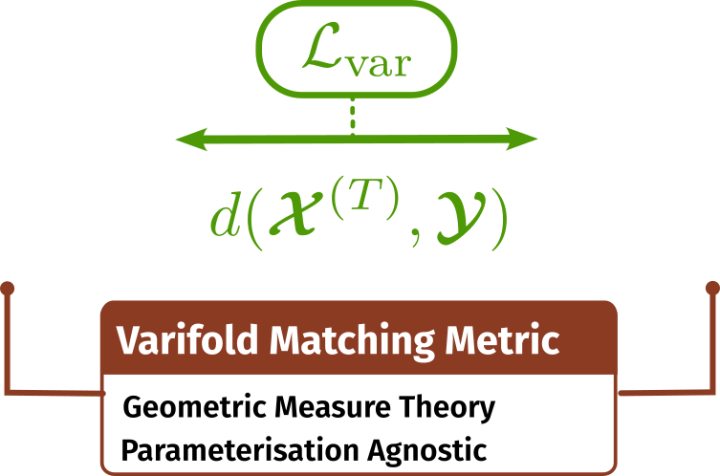
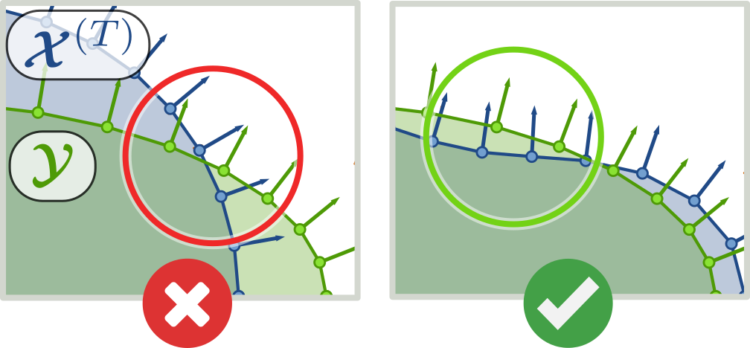
Existing Work – ARC-Flow [3DV 2025]
Notes:
This paper builds on our previous work, ARC-Flow, which achieved state-of-the-art results.
CLICK - ARC-Flow models deformation as a diff-eo-morphic flow, guaranteeing smooth, topology-preserving transformations.
CLICK - The flow is implemented as a Neural ODE, with volume preservation enforced by a divergence-free field.
CLICK - Surface alignment is handled using Varifolds
CLICK a correspondence-free metric that compares surfaces based on spatial proximity and normal alignment.
They are invariant to mesh parameterization and robust to noise but can struggle in regions of high curvature. More on this later.

Slide 4
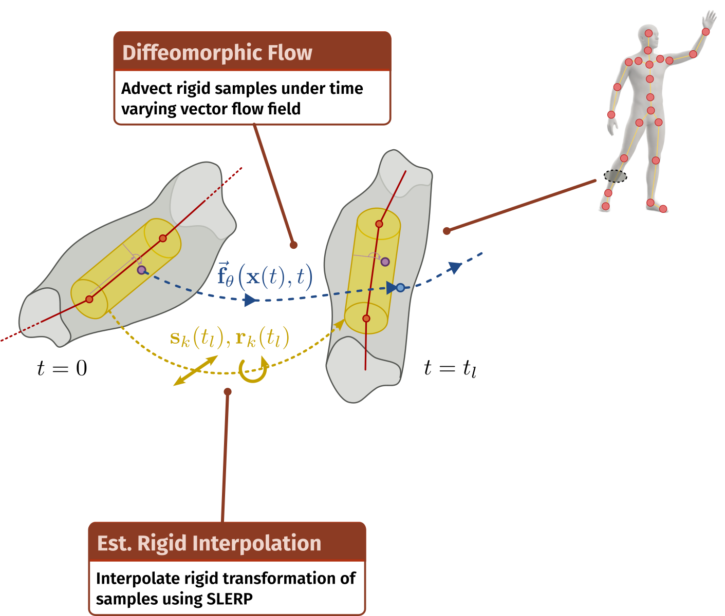
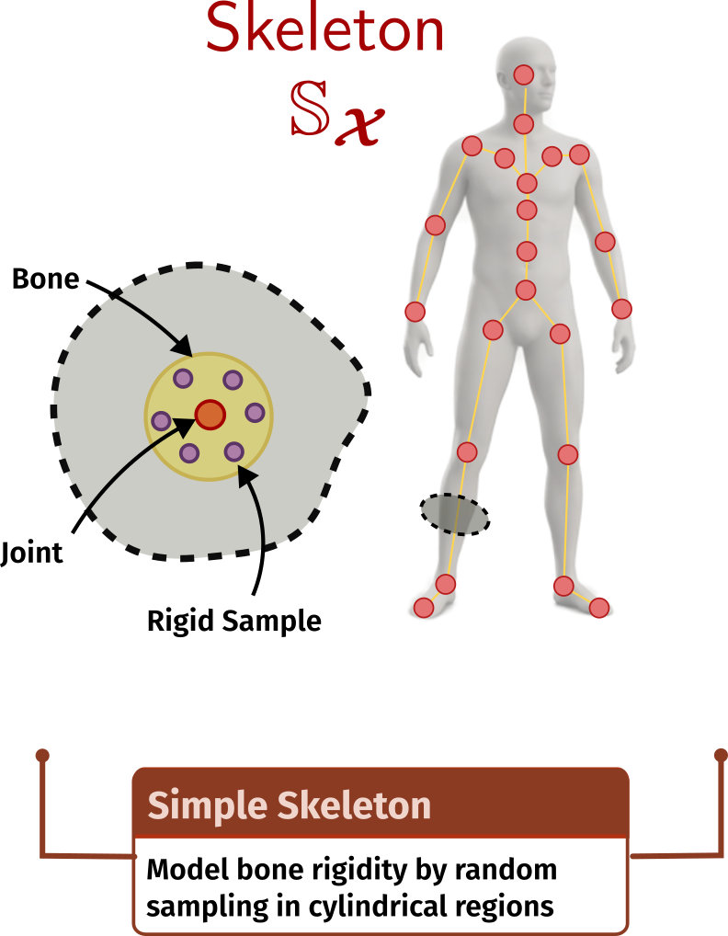
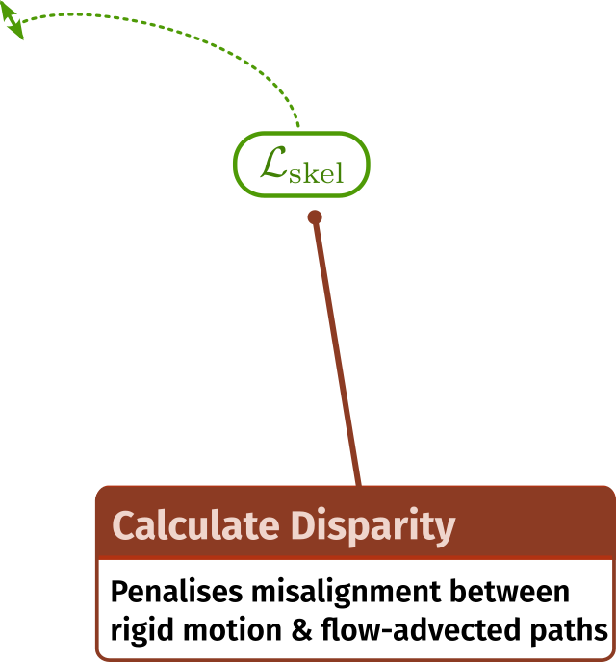
Existing Work – ARC-Flow [3DV 2025]
Notes:
For articulated shapes, biological motion is driven by an internal skeleton.
In ARC-Flow a simple skeleton is added to the source. Its worth noting, this is merely a topological graph , not a skinned rig, and applies to only the source.
Samples are drawn from bone-adjacent regions to define a proxy volume that should move rigidly with each bone.
CLICK – During training, deviations between learned rigid trajectories, interpolated using SLERP, and deformation trajectories induced by the flow are penalised.
This soft constraint encourages articulated rigidity.

Slide 5
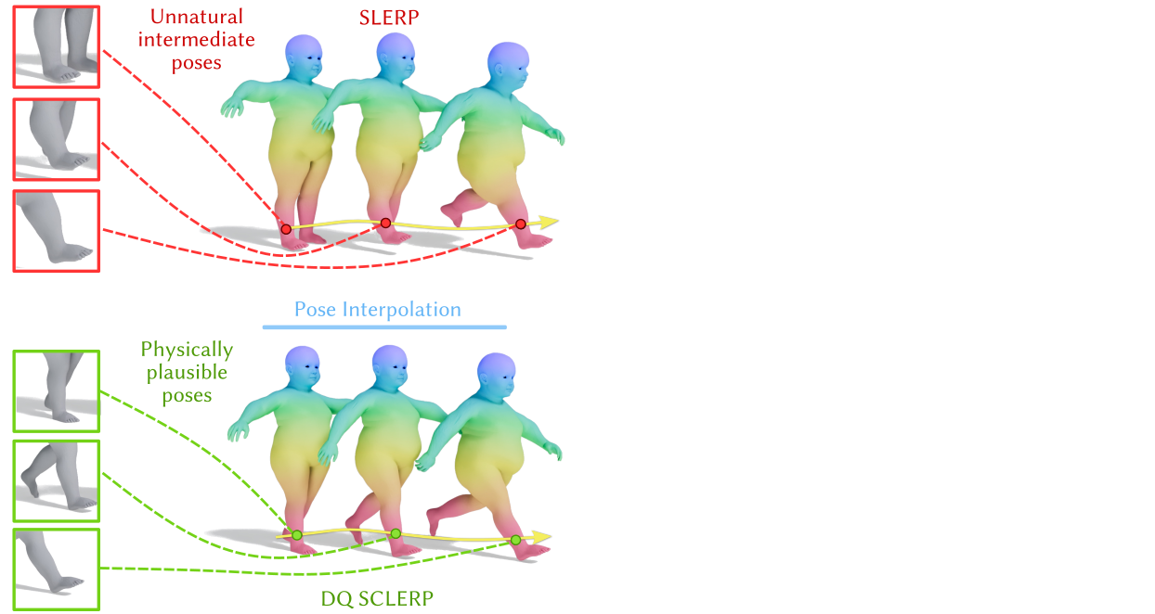
Contributions
Notes:
We propose three key improvements.
First, we replace quaternion SLERP with dual-quaternion ScLERP, which interpolates rigid transformations in SE(3) via a constant-twist motion, yielding more physically plausible articulation.

Slide 6
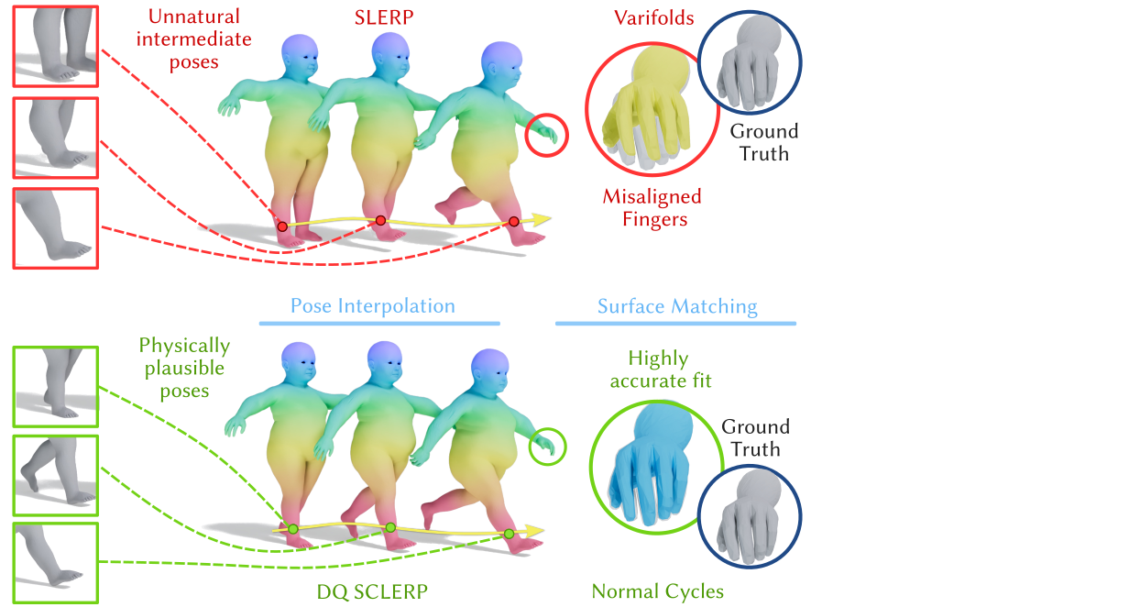
Contributions
Notes:
Second, we replace Varifolds with Normal Cycles, a metric that captures higher-order surface geometry by incorporating curvature into the similarity measure.

Slide 7
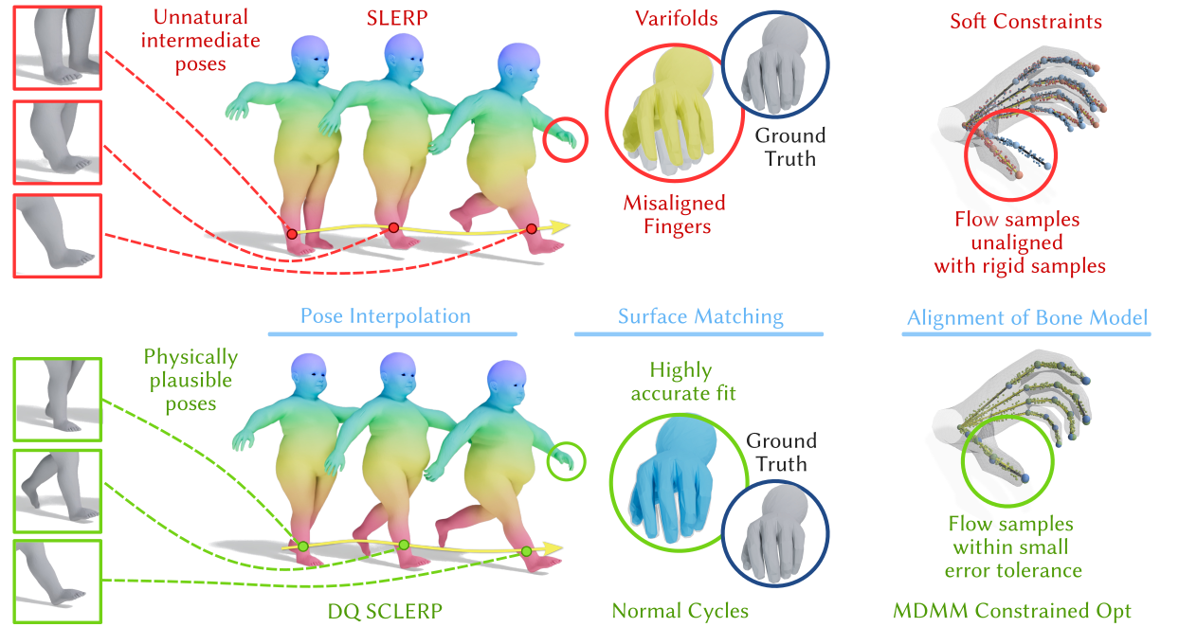
Contributions
Notes:
Third, we employ Constrained Optimization via the Modified Differential Method of Multipliers. Replacing soft penalties with hard constraints guarantees that rigid samples are strictly driven by the articulated model, eliminating drift.

Slide 8
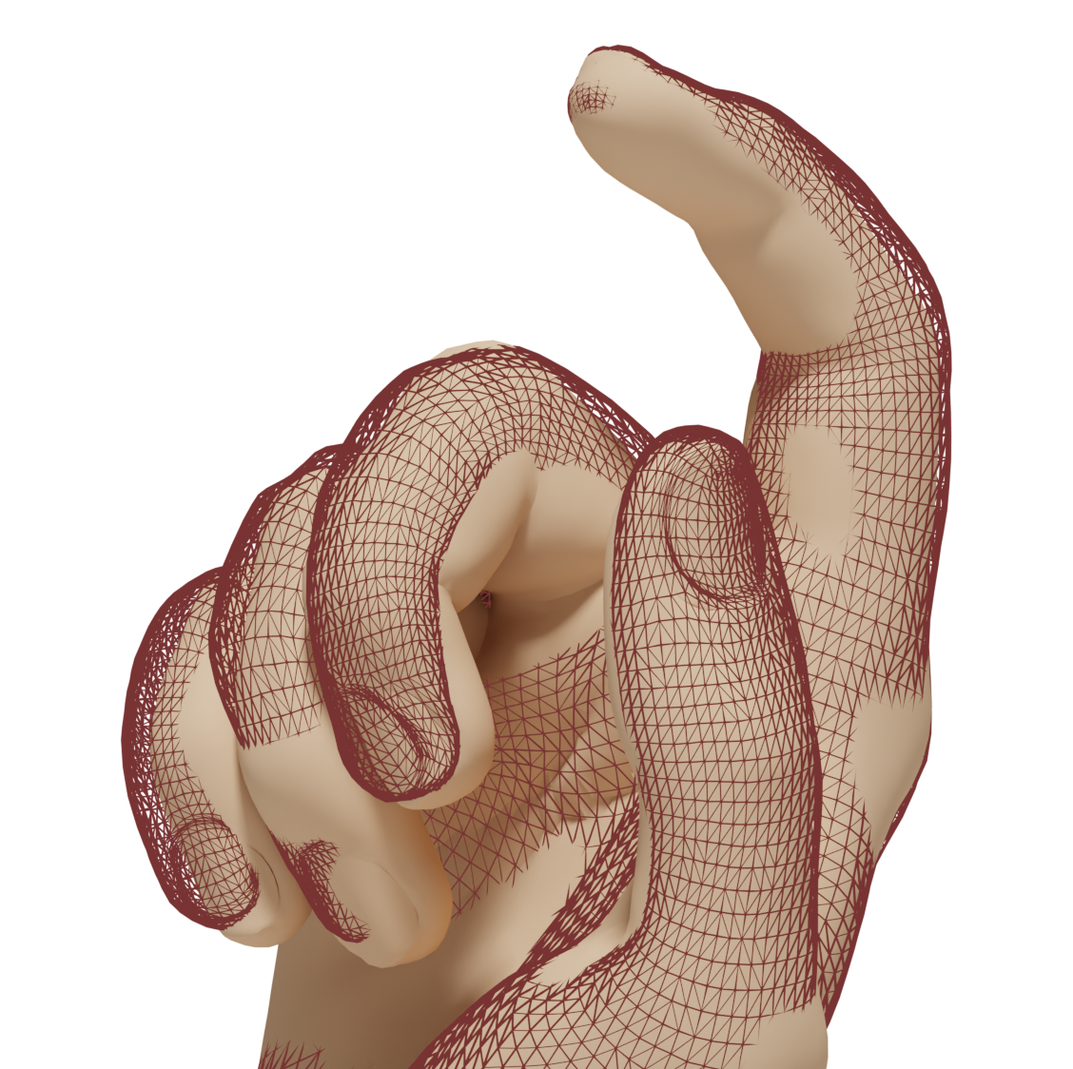
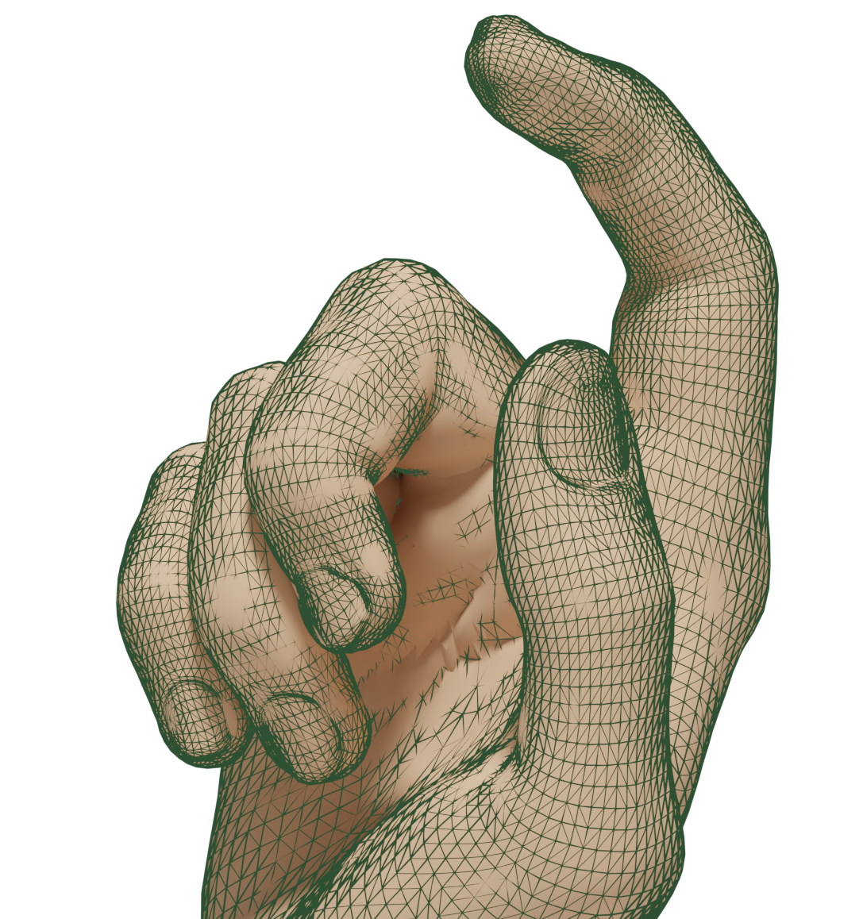
Varifolds vs Normal Cycles
Varifolds
Normal Cycles
(ARC-Flow)
(Our Method)
Notes:
So why do we need a more expressive metric?
CLICK - When fitting to this curled hand, we can see ARC-Flow struggles to match the high-curvature details at the knuckles and fingertips. Why might this be.
Well, the Varifold metric encourages spatially close points to share similar normals. However, it imposes a single global length scale. This 'one-size-fits-all' approach lacks the sensitivity to capture fine, high-curvature details.

Slide 9
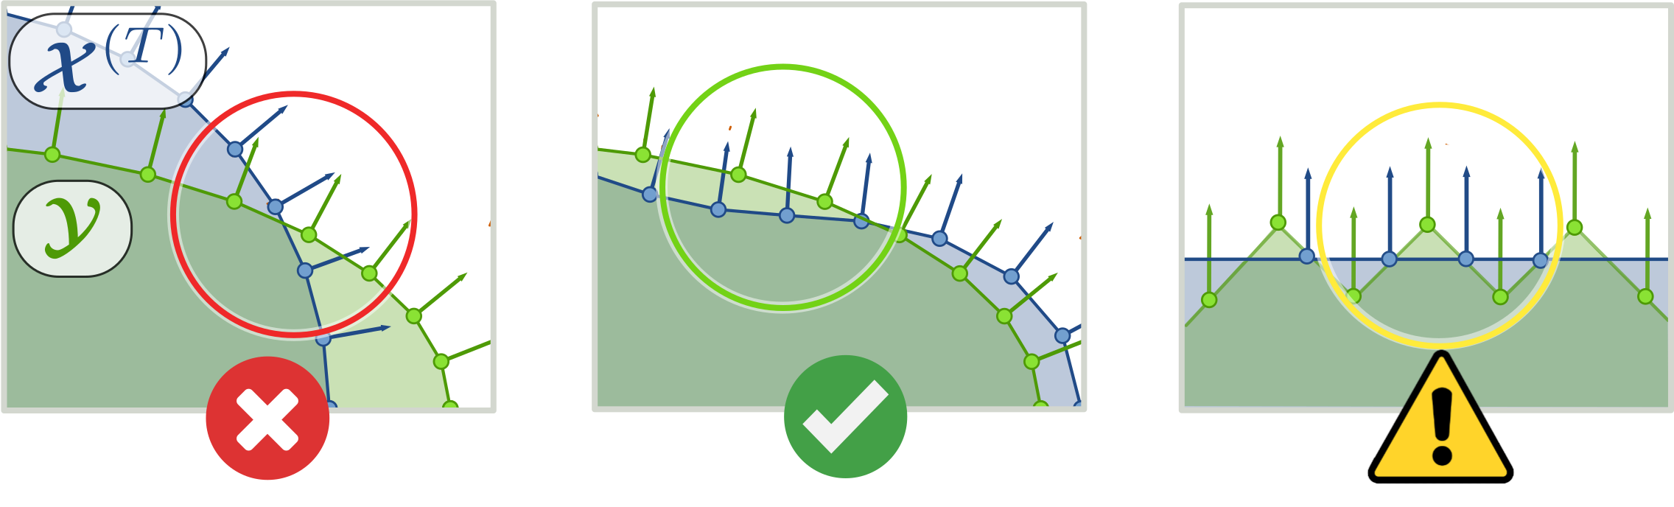
Normal Cycles – Intuition
Notes:
Let’s visualize this limitation in 2D.
In the left scenario, conflicting normals correctly trigger a high penalty. In the middle, better consistent alignment yields a lower cost.
However the scenario on right reveals a critical blind spot. Although the geometry is jagged, the surface samples are spatially close and the normals average out to match.
This tricks the metric into seeing a 'good' fit where there isn't one.

Slide 10
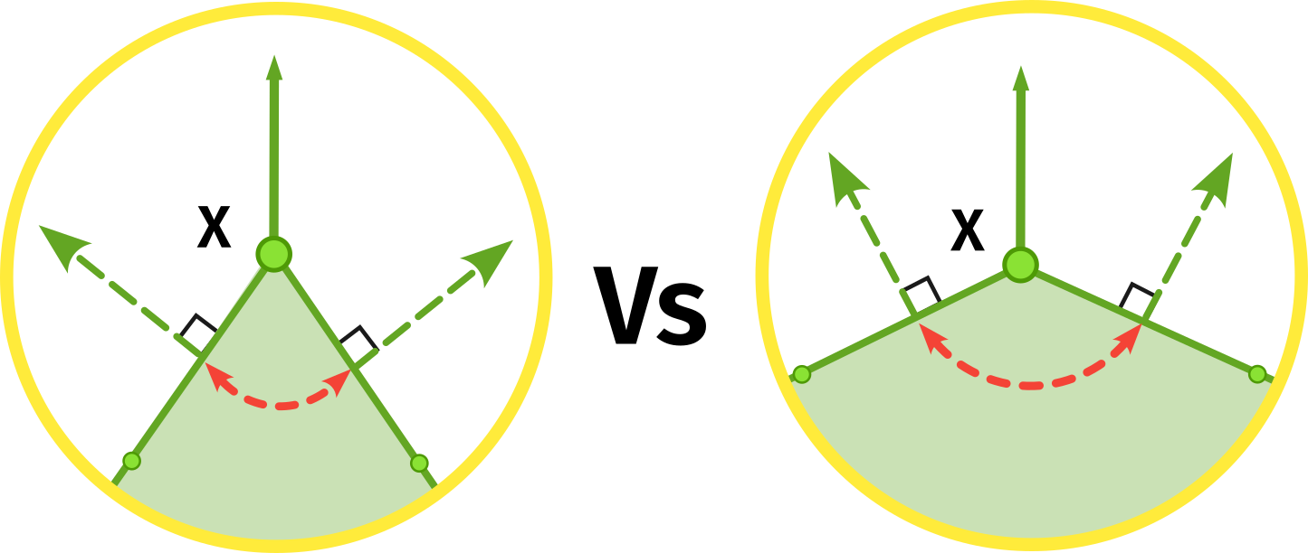
Normal Cycles – Intuition
Bundle of Normals
Notes:
OK, before some scary sounding maths, here is the key takeaway of my talk.
The normals at the point X are identical, but are actually representing quite different underlying surfaces.
Normal Cycles address this by considering the full bundle of normals at each location. This gives a representation that encodes extrinsic geometry, including curvature.

Slide 11
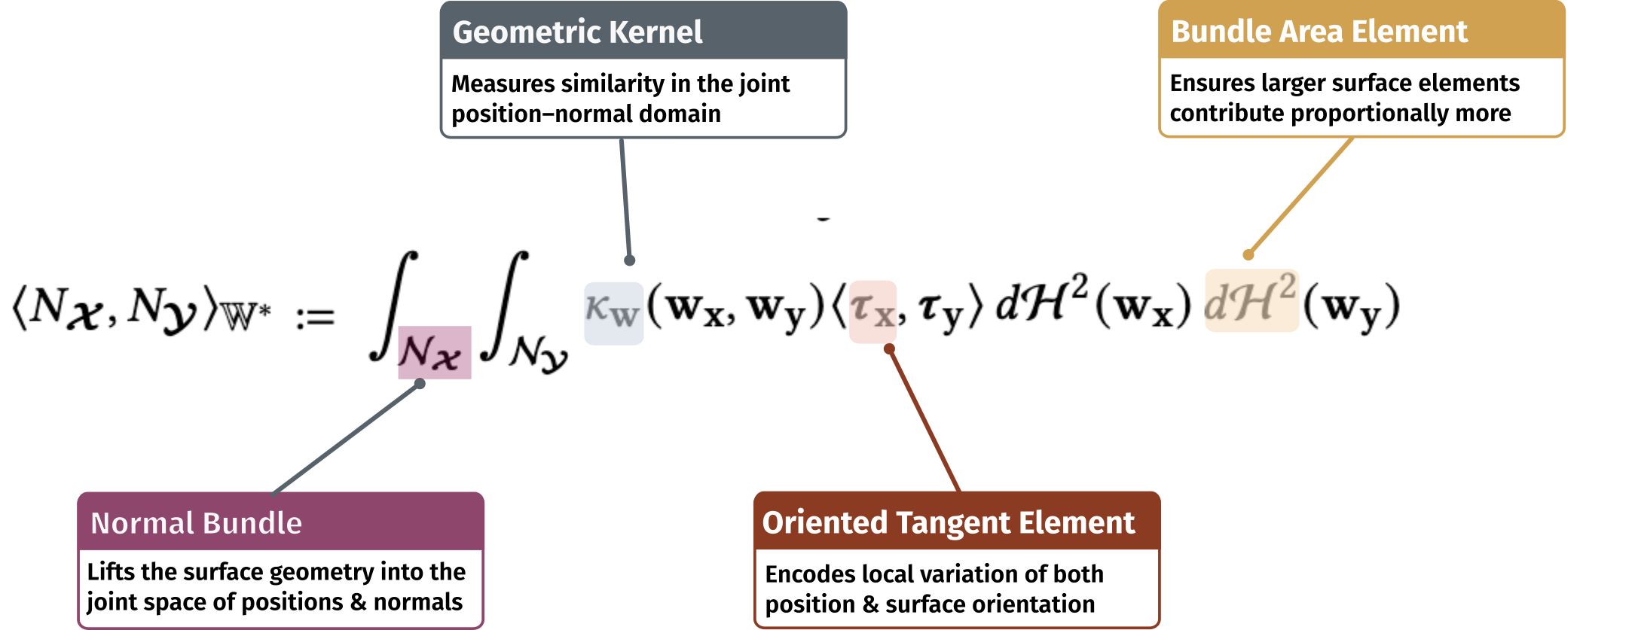
Normal Cycles – The Mathsy Bit !
Notes:
We embed this representation into a Reproducing Kernel Hilbert Space, yielding the following metric.
We integrate over the Unit Normal Bundle, lifting our matching problem from simple surface points to position-normal pairs.
The Kernel measures proximity in this joint domain.
Crucially, the Oriented Tangent Element, tau, encodes the local geometry. The inner product of these terms compares the structure of the surface at each point. This rewards not just similar directions, but matching curvature.

Slide 12
Normal Cycles – The Mathsy Bit !
NC Matching Metric
Notes:
As with Varifolds, we compute shape similarity using the inner-product distance in the Hilbert space.
CLICK - The main trade-off is computational cost, which scales quadratically with the number of surface samples.

Slide 13
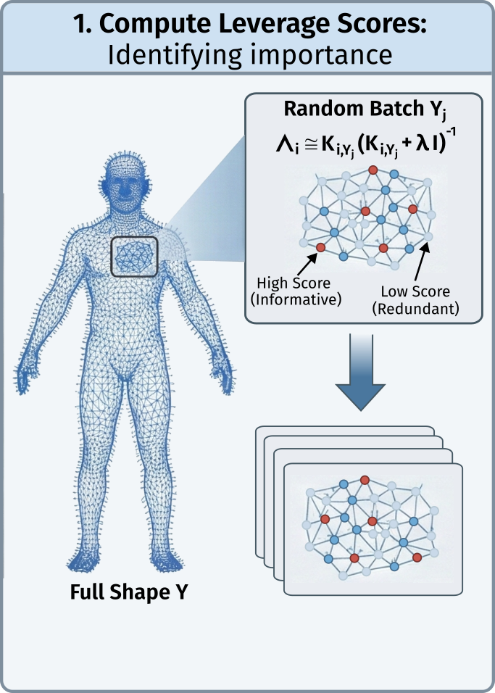
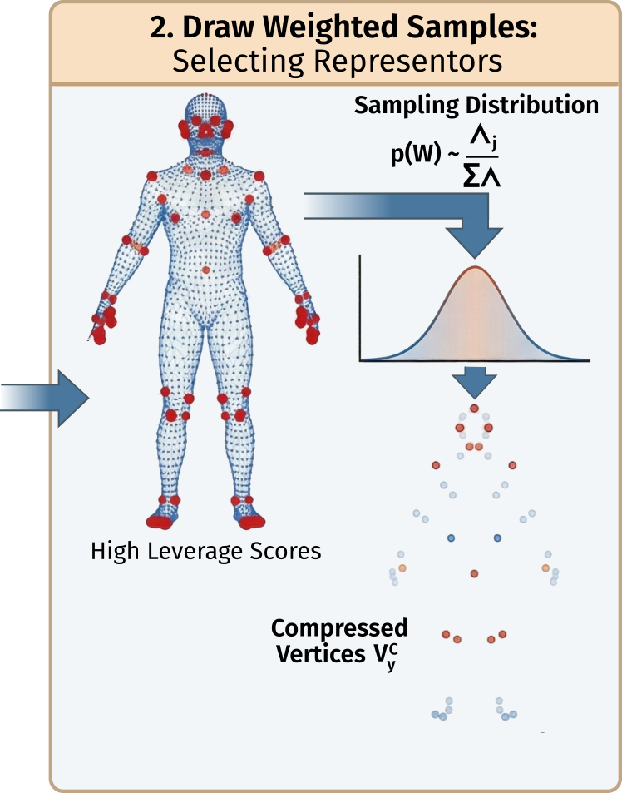
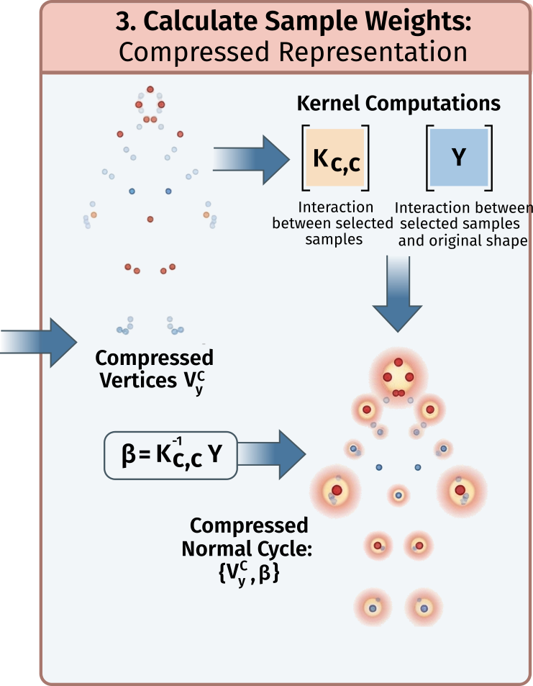
Compressed Representation of Normal Cycles
Notes:
We achieve computational efficiency by distilling the dense mesh
CLICK - into a sparse, adaptive set of weighted Representors that are guaranteed to closely approximate the true surface geometry.

Slide 14
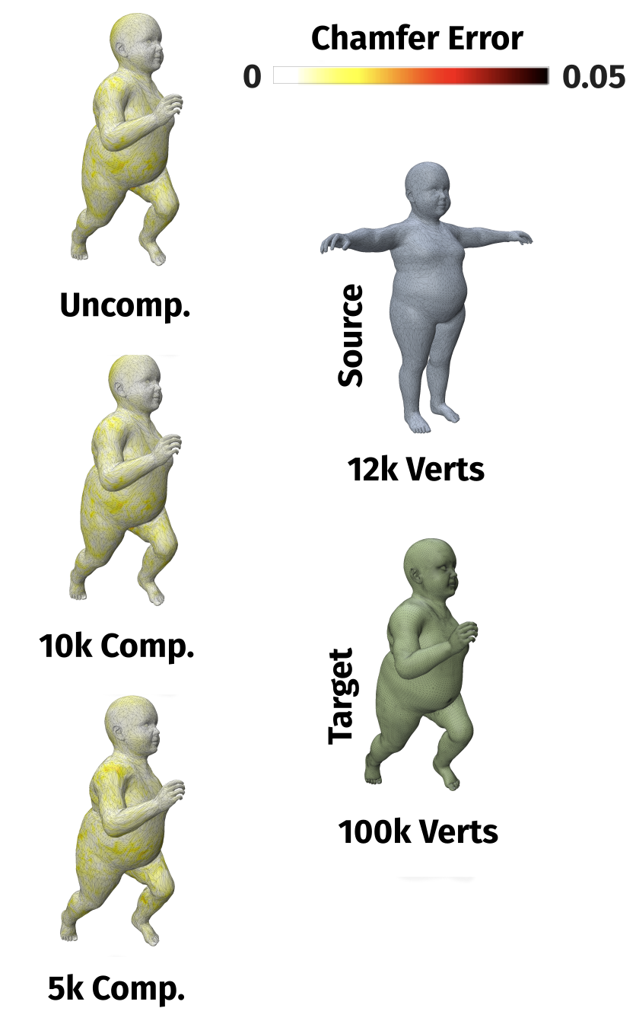
Compressed Normal Cycles Performance
Notes:
Traditional methods often struggle to scale due to a reliance on solving costly permutation matrices. By contrast, using our compression approach, training times remain constant as mesh complexity grows.
CLICK – We compress a 100,000-vertex target by up to 95%—fitting to just 5,000 and 10,000 representators, all while recovering identical alignment quality.
CLICK, CLICK, CLICK

Slide 15
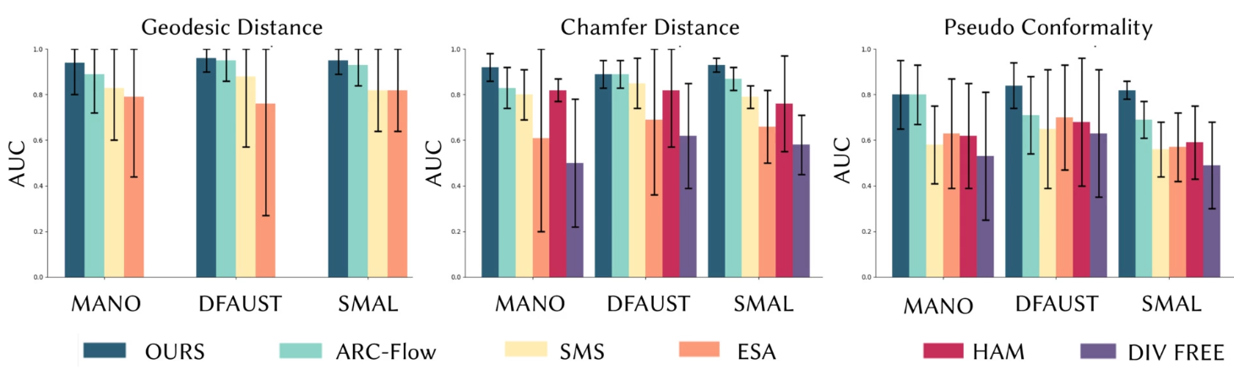
Quantitative Results - Summary
Notes:
We evaluate against a range of existing methods
CLICK across multiple datasets
CLICK using three metrics: geodesic distance for correspondence, Chamfer for surface fit, and Pseudo-Conformality for geometric preservation
CLICK - We quantify performance using the standard Area Under the Curve (AUC) metric, where a higher value signifies superior accuracy.
We outperform all baselines with higher accuracy and greater consistency, robustly handling large pose changes while capturing fine details.

Slide 16
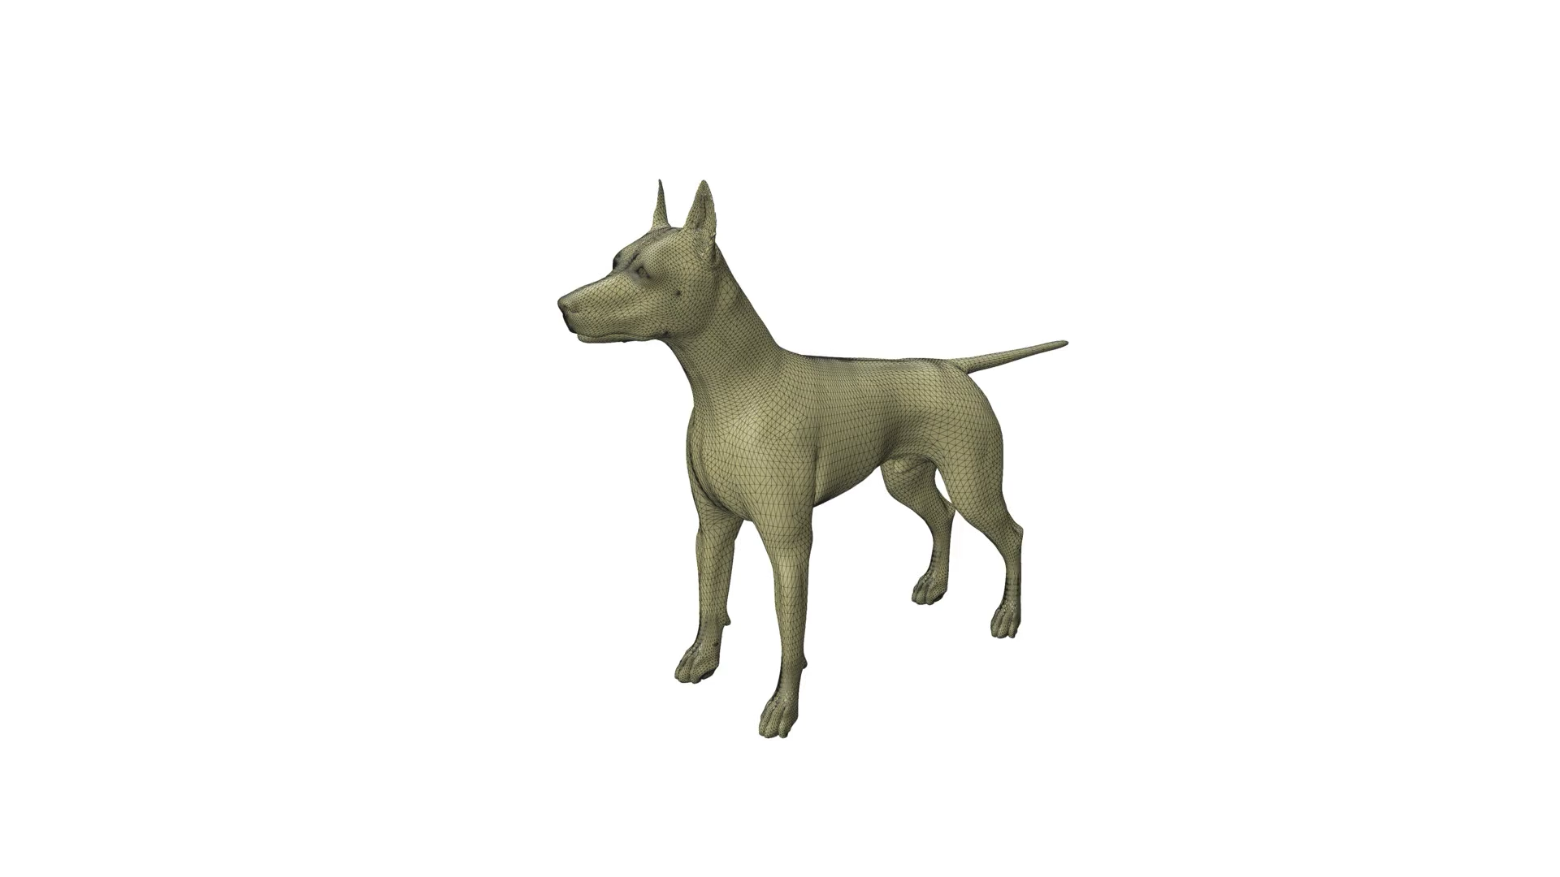
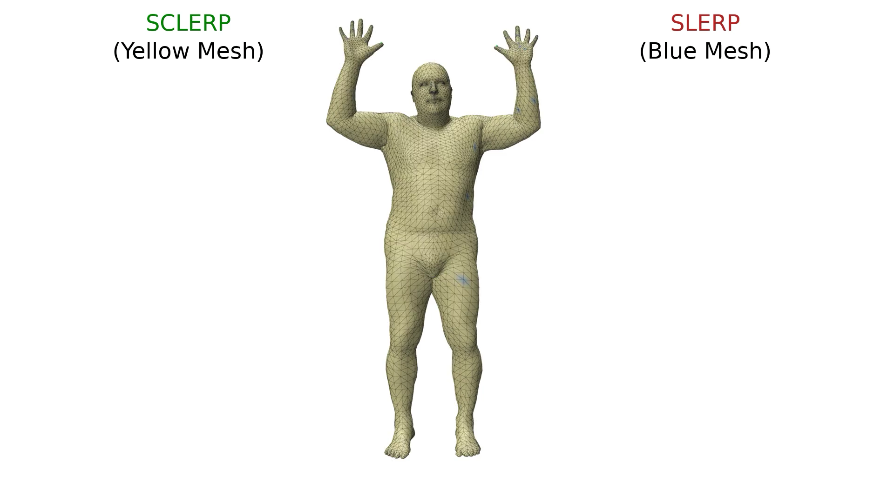
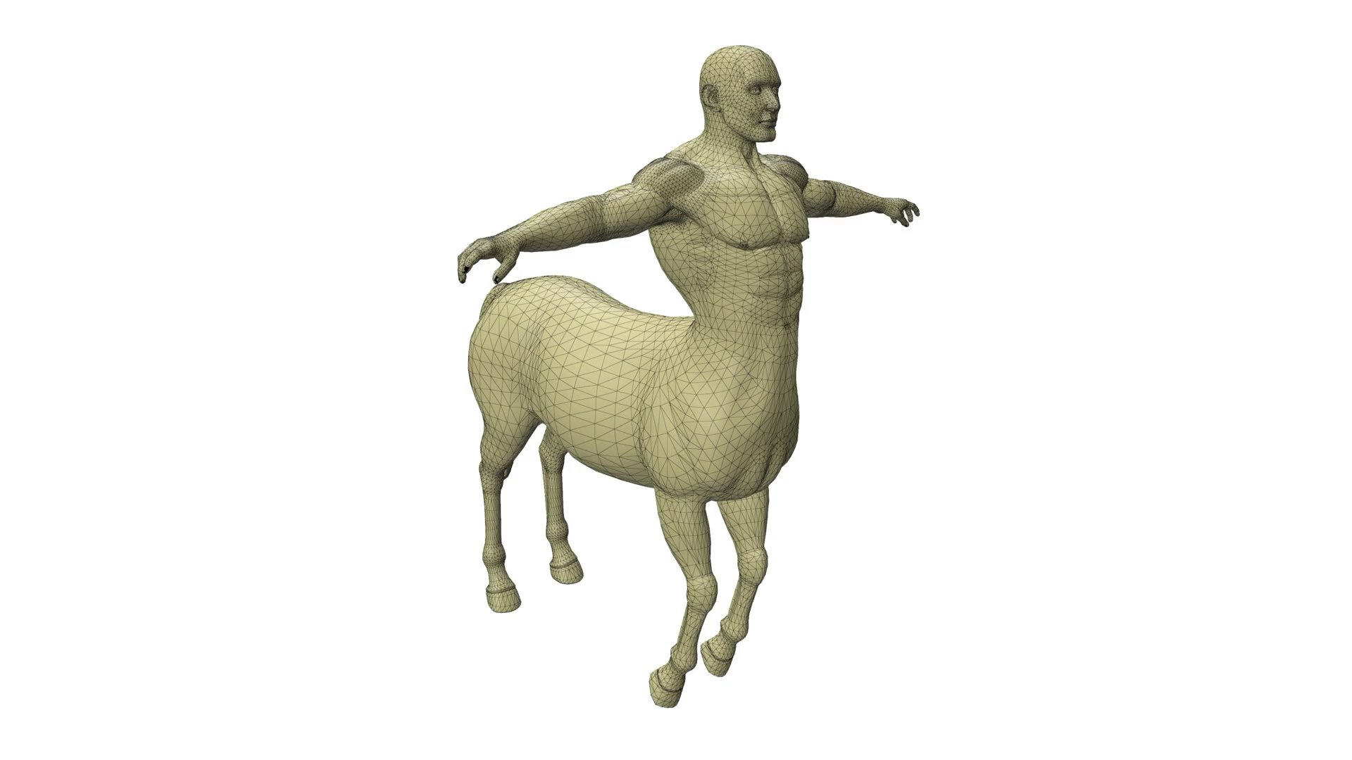
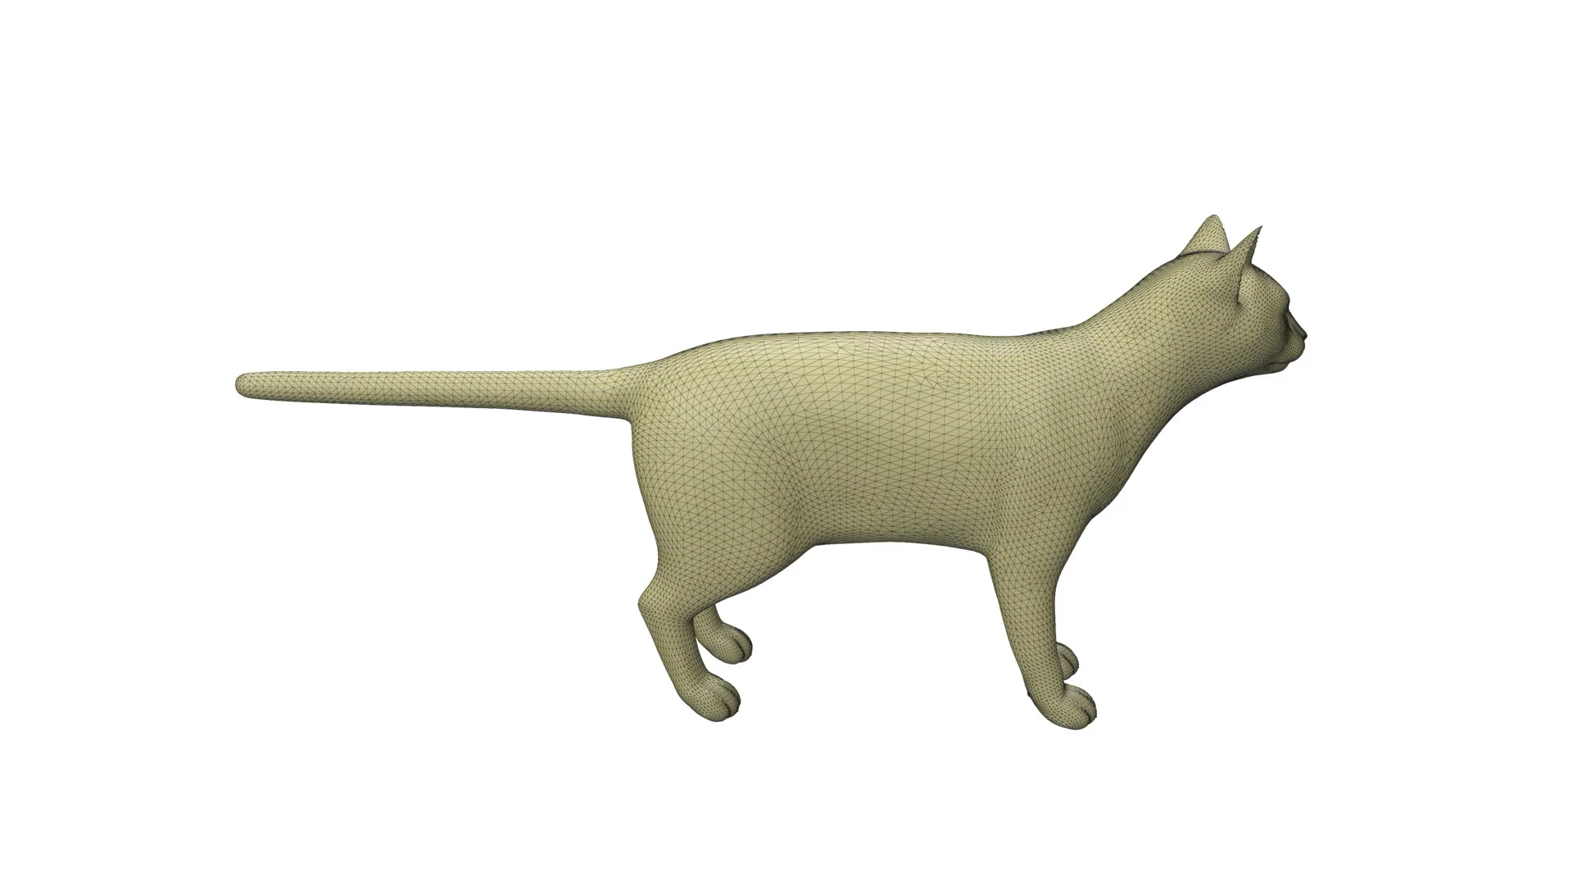
SCLERP vs SLERP
TOSCA Interpolations
Notes:
On the left, compare the trajectories of the hands between two poses from DFAUST dataset.
ARC-Flow in red produces an unnatural looking animation, while our method in green traces a more physically plausible path.
While on the right, we show results from fitting to poses from the TOSCA dataset. As you can see, our method recovers smooth high quality interpolations.

Slide 17
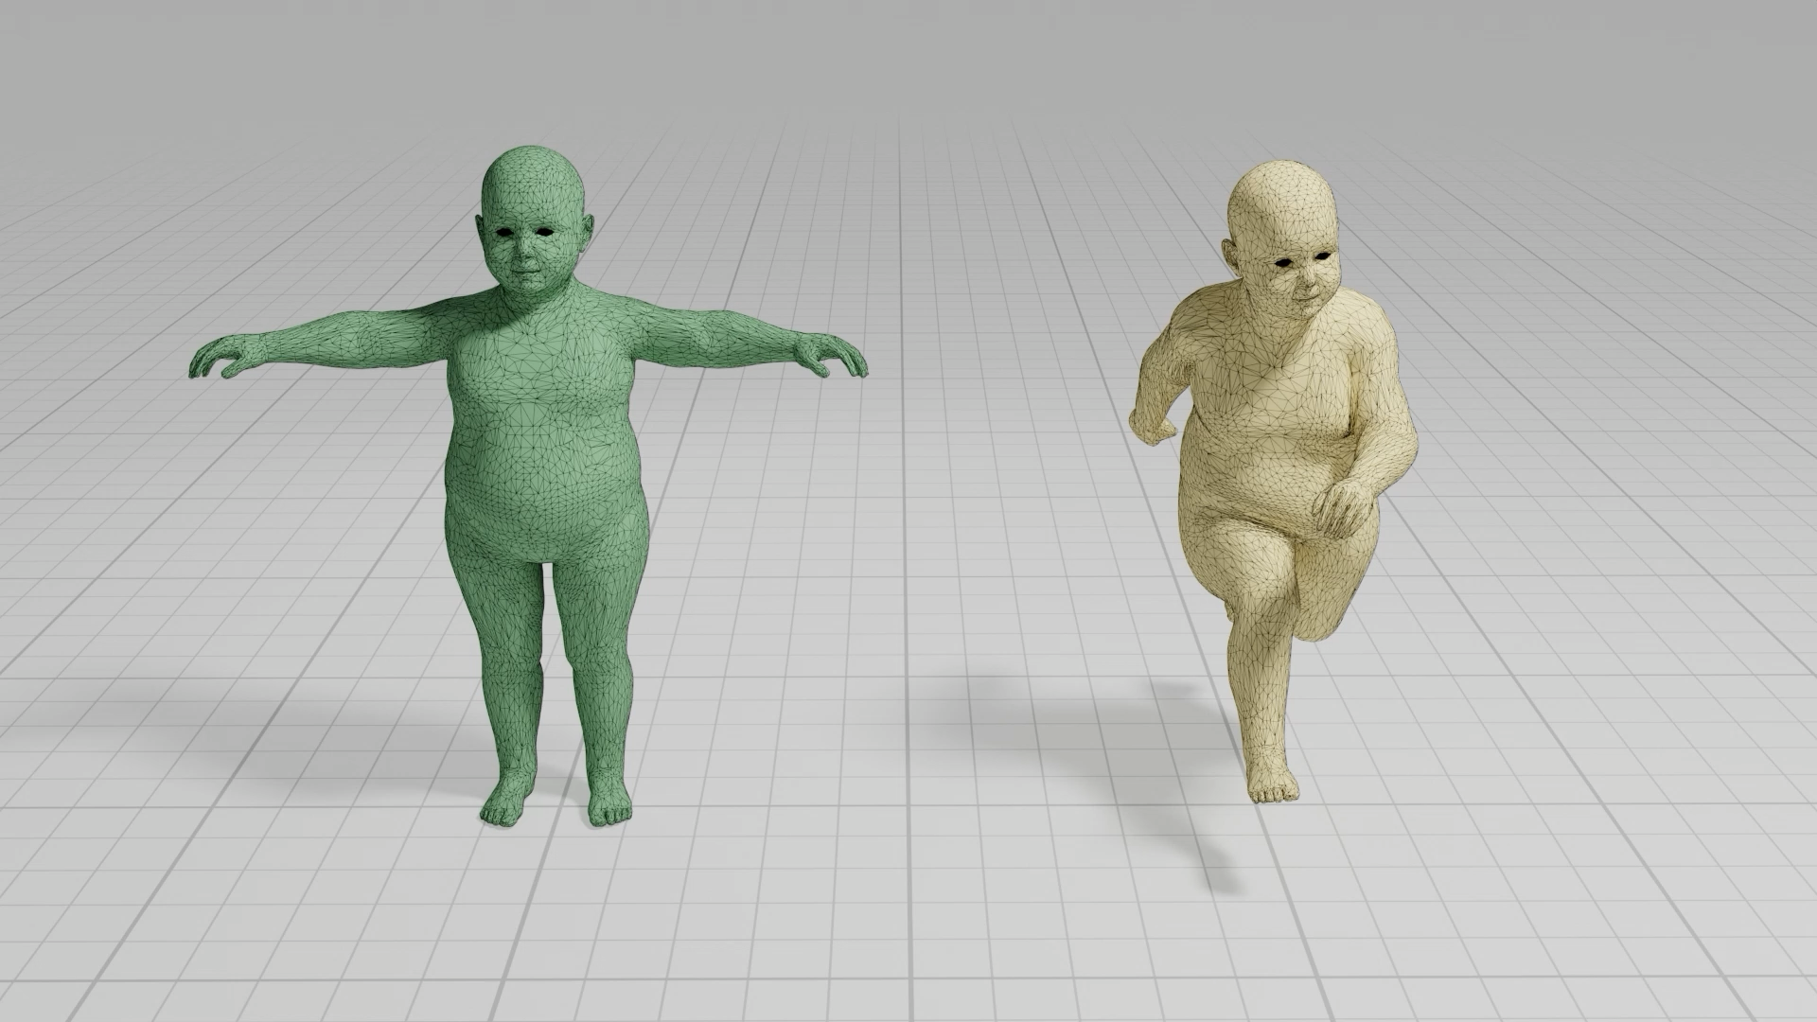
Top Kids Result
Notes:
The TopKids dataset has deliberately poor quality triangulation which makes it a challenging dataset for many methods.
However, with our approach the interpolated skeleton drives smooth surface recovery without mesh artifacts.
Low Chamfer distance error and stable correspondence confirm high geometric accuracy throughout.
This accuracy is maintained under Normal Cycle compression even as vertex count increases.

Slide 18




Curvature Enthusiasm delivers
Key Takeaways & Future Work
Read the Paper
Accurate Dense Matching
curvature-enthusiasm.github.io/
Physically plausible interpolations
Explore the Code
github.com/neural-geometric-shape-models/curvature-enthusiasm
Efficiently handles to high resolution meshes
Contact Us
Limitations & Future Work
ath35@bath.ac.uk
Assumes constant identity
Matching partial shapes
Come see us at Q&A for more details & results
Notes:
In conclusion, our method learns physically plausible interpolations, recovers accurate dense matching even in complex regions, while scaling to high-resolution meshes.
However, it is not without limitations.
We assume constant identity. Extending to change of identity is an interesting direction for future work.
Furthermore, extending Normal Cycles to partial matching would enable direct use of incomplete real-world scans without preprocessing.
Thank you very much for your attention. For further details on our method and additional results, please join us at the interactive Q&A session.
I also encourage you to visit the links shown, where you can find the paper and code.

